Slide 1
The Data Incubator Project Outline
Mikhail Gaerlan

Slide 2
Outline
Goals
Data
Metrics
Histograms
Approach
Similar Work
Naïve
TF-IDF
Eigenvector Centrality
Results
Final Product

Slide 3

Goals
Develop and host a website where users can submit a query to find similar subreddits.
This Photo by Unknown Author is licensed under CC BY-SA-NC

Slide 4
Data: Metrics
Source: https://www.kaggle.com/josephleake/huge-collection-of-reddit-votes/
A total of 44,863,247 unique votes are represented. 34,569,390 (77%) were upvotes. 10,293,857 (23%) were downvotes. 22,626,222 unique submissions voted on. 35,716 unique users are represented. 139,891 unique subreddits are represented.

Slide 5
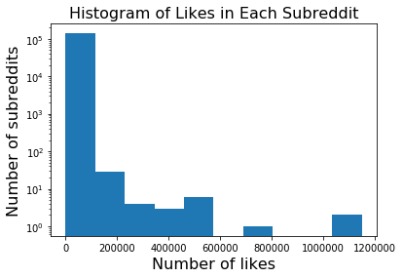
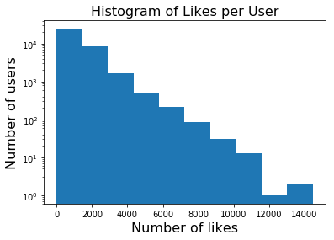
Data: Histograms

Slide 6
Approach: Similar Work
Other websites to find similar subreddits.
https://anvaka.github.io/redsim/ and https://anvaka.github.io/sayit/?query= Uses Jaccard index to rank similarity based on user comments. Does not work well for very popular subreddits.
https://subredditstats.com/subreddit-user-overlaps/. Calculates probability that a user of a subreddit will post or comment in another subreddit. No link to data source or methodology.

Slide 7
Approach: Naïve
Get the users of a subreddit.
Get all the likes from each of those users.
Count the number of likes for each subreddit
Example: Top 10 most liked subreddits from users of r/politics
Subreddit | Number of likes
r/funny | 737812
r/pics | 553388
r/The_Donald | 433100
r/worldnews | 370450
r/aww | 317774
r/gaming | 311413
r/AskReddit | 280606
r/videos | 258951
r/todayilearned | 249299
r/dankmemes | 219101

Slide 8
Approach: TF-IDF
Problem: Most popular subreddits of users of a specific subreddit are not necessarily similar.
Popular subreddits get attention from large numbers of users regardless of similarity.
To get similar subreddits, we need to filter popular subreddits among all users.
Solution: Use a modified TF-IDF weighting scheme to offset popular subreddits.
The TF value evaluates the number of likes of other subreddits, and the IDF value offsets the popularity of the subreddits amongst other users.

Slide 9
Approach: Eigenvector Centrality
Problem: Subreddits with small numbers of users with a large number of likes get ranked high regardless of similarity to other subreddits.
Solution: Form a network based on the number of shared users between subreddits and rank them based on eigenvector centrality.
The relevance of a subreddit should also be based on a network of shared users.

Slide 10
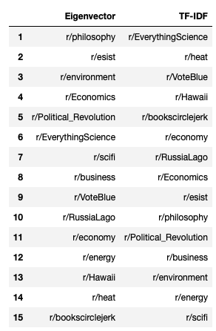
Approach: Results
Search results of r/science.
Some results are clearly not relevant.
r/heat is the subreddit for the Miami Heat basketball team and not scientific concept of heat.
The eigenvector centrality ranks r/heat lower due to its irrelevance to the other results.

Slide 11
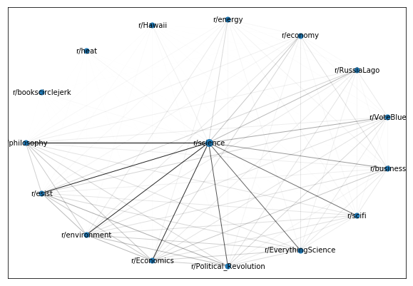
Approach: Results
The subreddits to form a network were first filtered using the TF-IDF weighting scheme
Subreddits are sorted in a counter-clockwise order based on eigenvector centrality.
The most well-connected subreddits are ranked highest.

Slide 12
Final Product
A website where users can submit queries.
Generate links to subreddits.
Needs a host to either calculate data and store results.
Potentially use host to gather new data to store.
Generate visualization of networks.

